Slide 1

Petabyte Pirates

Slide 2

Desired Goal(s)
Interests included:
Housing market trends
Predicting failure of Infrastructure
Diagnostics for Healthcare
Diagnostics for Machine Maintenance
And a few more…
Decided on:
Predict the sale price of a house going up for sale

Slide 3
Selecting the Dataset
We examined the available datasets on
Kaggle
Data.gov
FiveThirtyEight
Zillo
Redfin
Chose
Ames Iowa Housing Sales from Kaggle
https://www.kaggle.com/datasets/shashanknecrothapa/ames-housing-dataset

Slide 4
Dataset Characteristics
Number of Instances: 2,930
Number of Features: 79
Data types include both numerical and categorical values
Record of home sales from January 2006 to July 2010

Slide 5

Discovery
Number of features
Ratio of missing data by feature
Correlation of features to actual sale price
Identified engineered features of interest
Correlation of engineered features to actual sale price
Scatter plots of all features having correlation > .50

Slide 6
Features
Identified 21 features
Overall Quality
Year Built
Year remodeled/addition
Total Basement SF
First Floor SF
Above Grade Living Area SF
Full Baths
Garage Year Built
Garage Cars
Garage Area
House Age
Remodel Age
Total SF
Total SF plus Garage
Total Baths
Price per Square Foot
Quality X Square Foot
Exterior Quality
Basement Quality
Kitchen Quality
Fireplace Quality

Slide 7
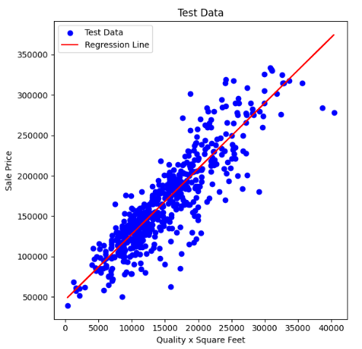
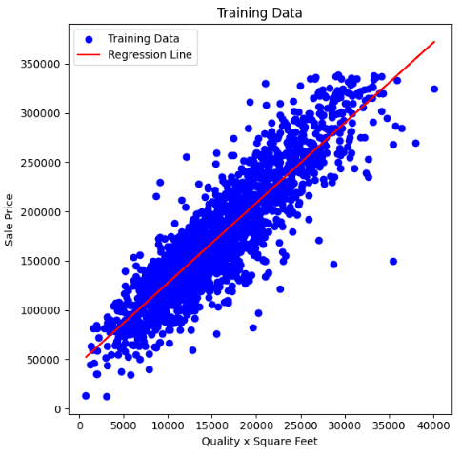
Analysis

Slide 8



Architecture
Front End Web Server
Back End Web Server
Web Application
ML Engine
Port 80/443
Rest API
Ames Iowa Home Sales
Port 5000

Slide 9
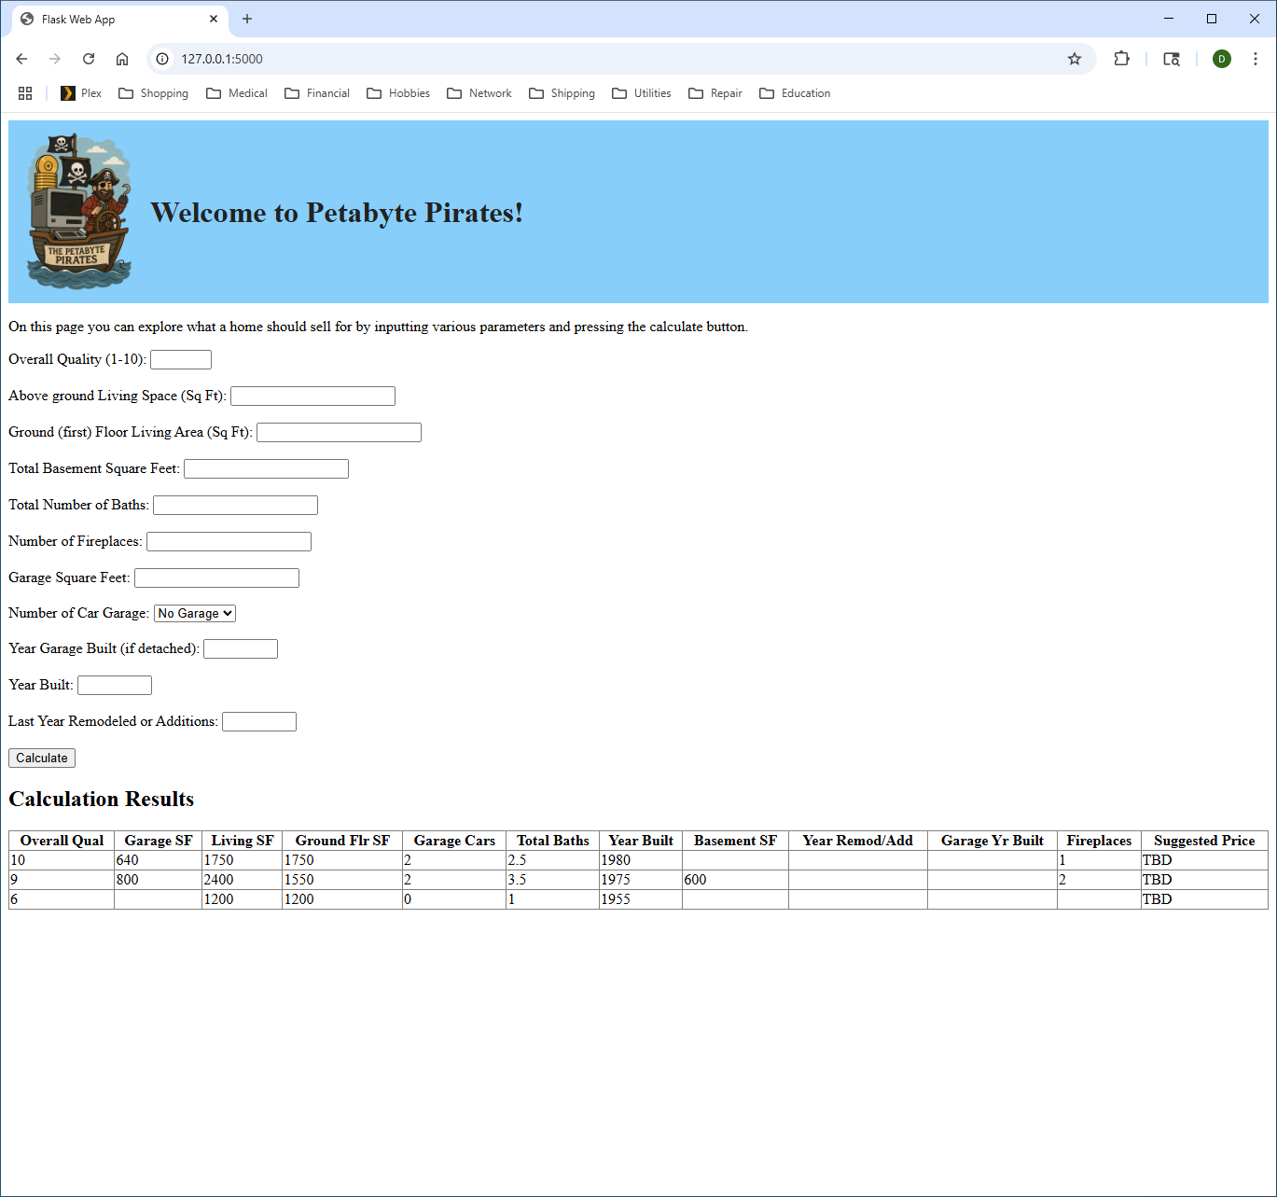
Presentation
Form for user to input parameters to predict price of home. The result of each request is saved as a table below, allowing “what-if” comparisons.
Each result of the input calculation is saved in a table. All columns of the table are sortable. This allows the user to perform what-if comparisons and to compare multiple properties.

